Slide 1

What is consciousness? Current orthodoxy
Consciousness: one’s subjective experience of the world, resulting from brain activity
  Current orthodoxy: The brain and the mind are inseparable.
  Qualia (quale)
  Each of us experiences consciousness personally.
  We cannot know if two people experience the world in exactly the same way.

Slide 2
Inverted Spectrum

Slide 3
Measuring conscious perception in the lab
How do we operationally define “conscious perception”?
Treating consciousness as a variable (you are conscious of something or not)
What is the role that attention plays in conscious and unconscious perception?
Do we perceive the world if we are not attending?

Slide 4
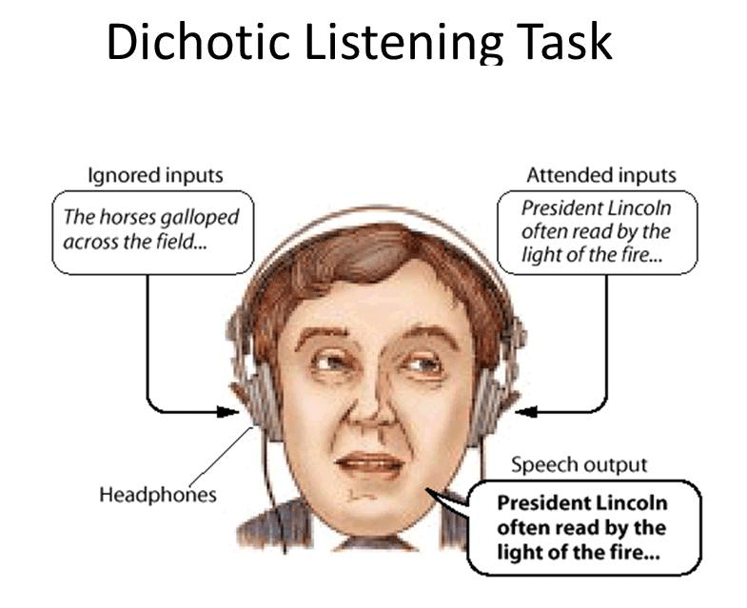
What do we consciously hear if we don’t pay attention? (Cherry, 1953)

Slide 5
Filter Theory of Selective Attention
Donald Broadbent developed filter theory to explain the selective nature of attention.
  In this model, attention is like a gate that opens for important information and closes for irrelevant information.
  Some stimuli demand attention and virtually shut off the ability to attend to anything else.
  Decisions about what to attend to are made early in the perceptual process.

Slide 6
Where goes this filter (attention) occur?
Early Selection Theory
Late Selection Theory

Slide 7
What do we consciously hear if we don’t pay attention? (Cherry, 1953)
What are the results of this experiment?
If the Early Selection theory is true, what do you predict you should hear pre-attentively (that is, without attention)?
If the Late Selection theory is true, what do you predict you should hear pre-attentively (that is, without attention)?

Slide 8
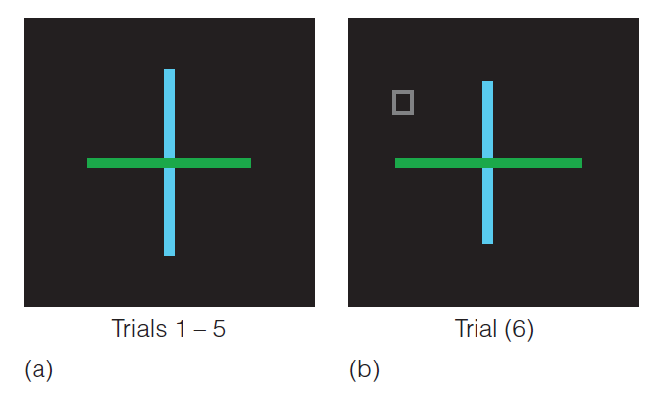
What do we see when we don’t attend?: Inattentional Blindness (IB)
Inattentional blindness (Mack & Rock, 1998)
  Subjects can be unaware of clearly visible stimuli if they aren’t directing their attention to them.
  What does this tell us about the relationship between attention and conscious perception?

Slide 9
What do we see when we don’t attend?: Inattentional Blindness (IB)
How much IB when stimulus is presented in the peripheral vision?
How much IB when stimulus is presented at the center of vision?

Slide 10
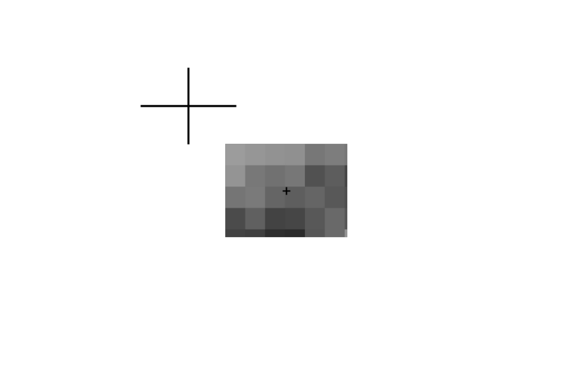
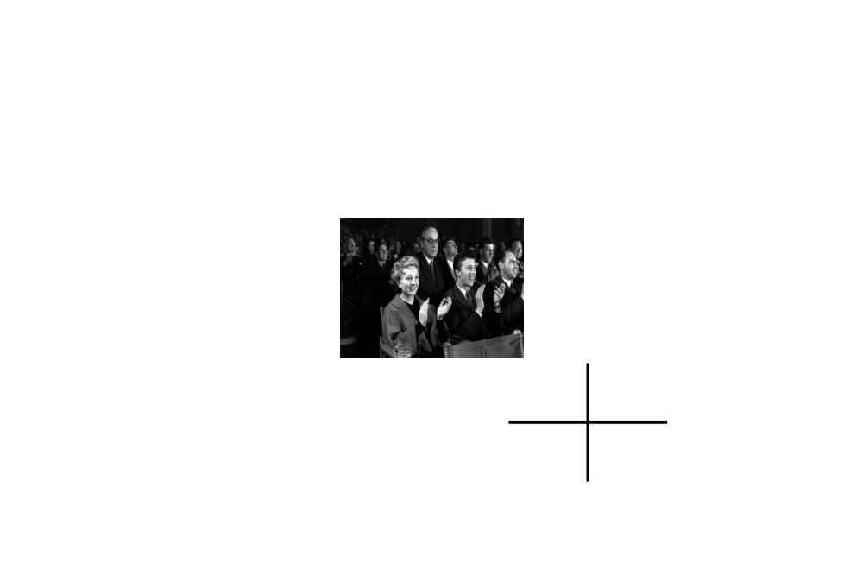
What do we see if we are not paying attention? (Mack & Clarke, 2012)

Slide 11
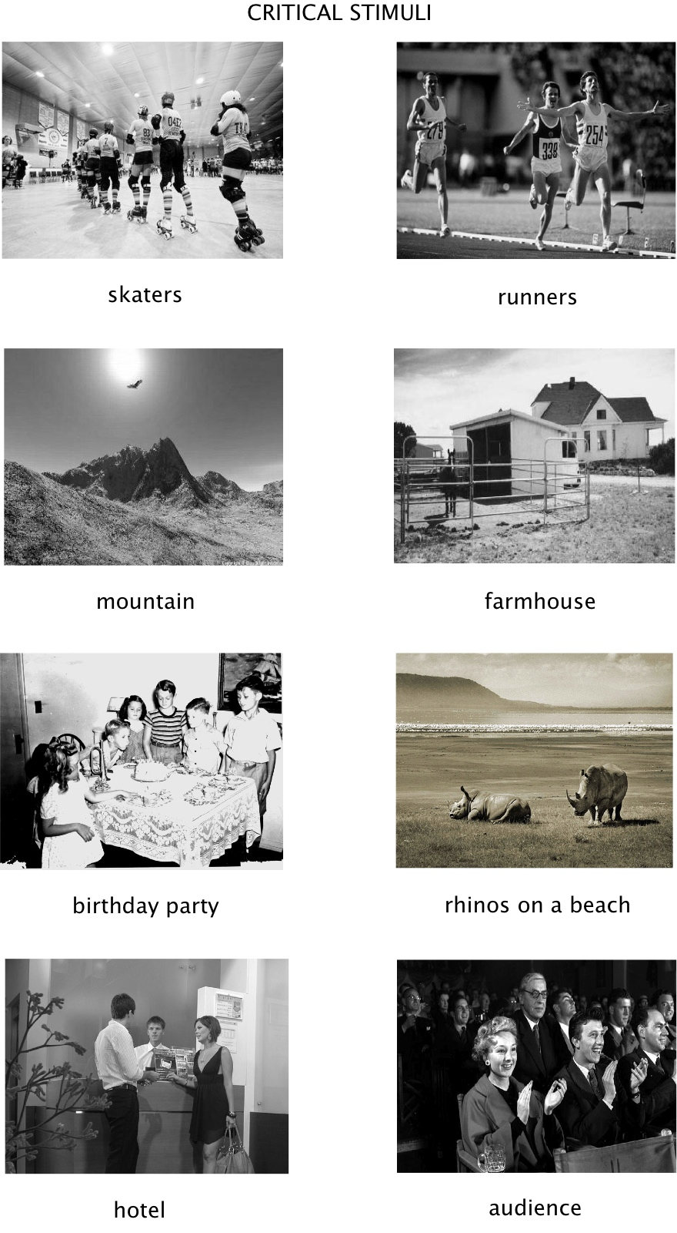
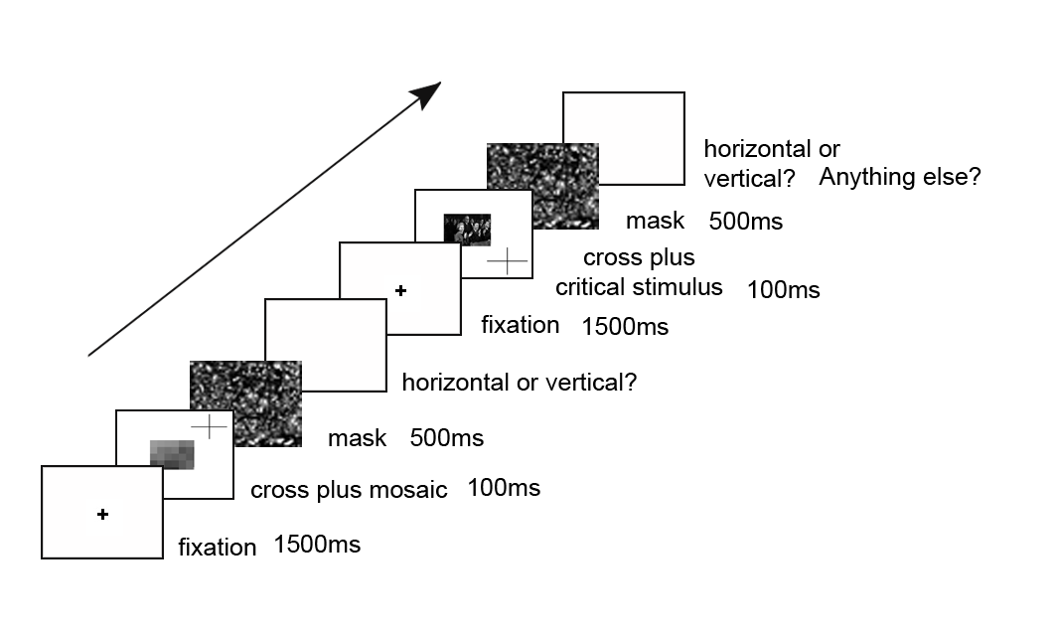
What do we see if we are not paying attention? (Mack & Clarke, 2012)

Slide 12
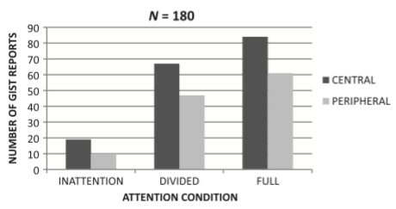
What do we see if we are not paying attention? (Mack & Clarke, 2012)
Experiment 1a: Scene central: 75% (45 of 60 subjects) were inattentionally blind (IB)
Experiment 1b: Scene peripheral: 85% (51 of 60 subjects) IB
Experiment 2a: Scenes with faces central: 87% (26 of 30 subjects)IB
Experiment 2b: Scenes with faces peripheral: 97% (29 of 30 subjects) IB

Slide 13
Are we IB to everything?
Mack and Rock found that only about 5% of subjects were blind to their own name when it was presented under conditions of inattention
Presenting someone else’s name led to 35% inattentional blindness
Presenting letters with only one different letter – e.g. “Kon” instead of “Ken” or “Jeck” instead of “Jack” led to about 60% inattentional blindness
Why?

Slide 14
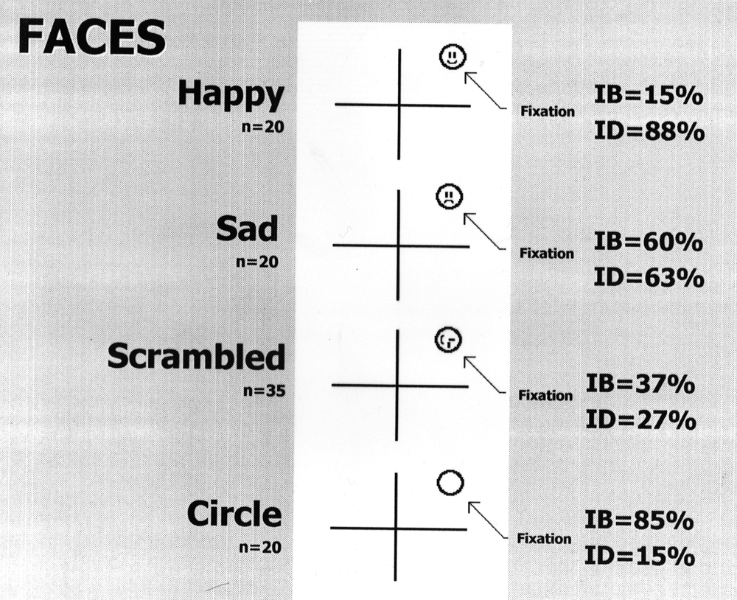
Are we IB to everything? (cont.)

Slide 15
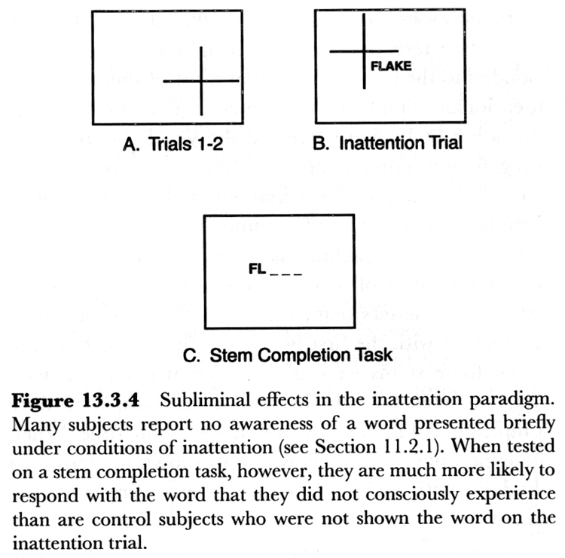
Evidence for unconscious processing of unattended stimuli?

Slide 16
IB Demos
Gorilla Experiment
The Monkey Business Illusion

Slide 17
What are some conclusions from these studies?
No conscious perception without attention (Mack & Rock, 1998)
Unconscious processing of input to semantic level
What are the real world applications?
Driving requires constant attention.
Strayer and Johnston research (2001) on cell phone use and driving
  Anything that distracts attention can degrade driving performance.

Slide 18
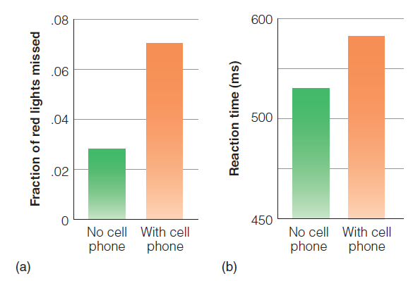
What are some conclusions from these studies?

Slide 19
What happens when we do not attend? Change Blindness
Change blindness demos
The Door Study
Another cool example
Clip from Brain Games on Change Blindness

Slide 20
Change Blindness
Change blindness: a failure to notice large changes in one’s environment
  Change blindness illustrates how selective an individual’s attention can be.
  What is the reason for change blindness?

Slide 21
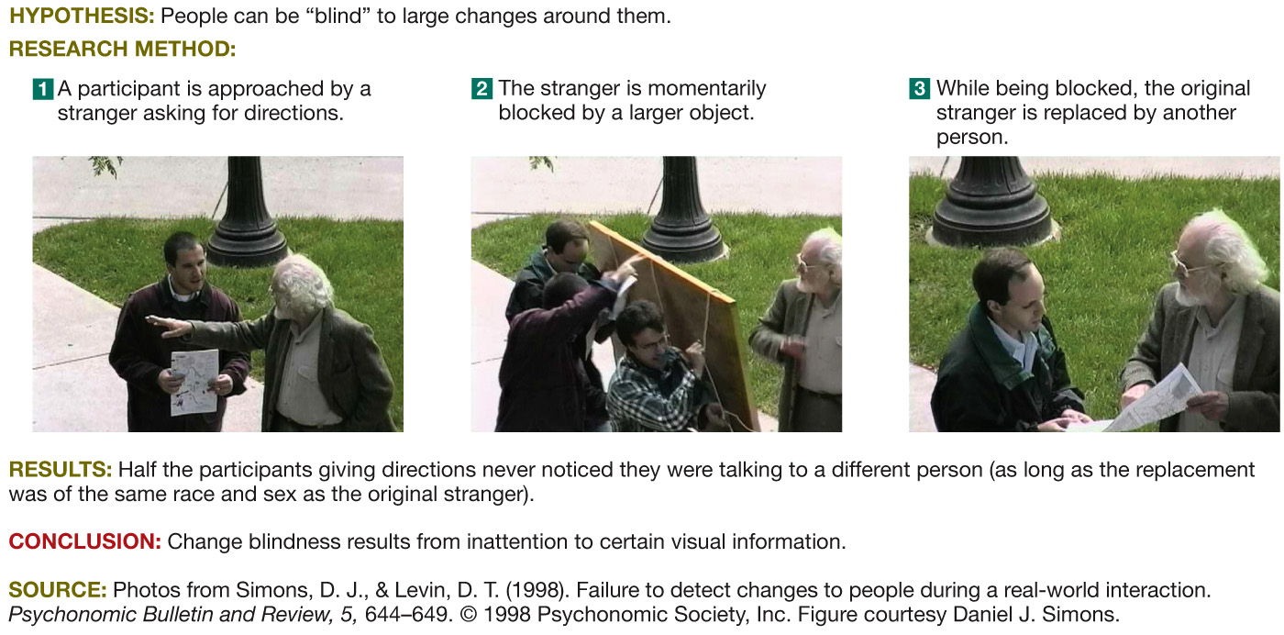
Change Blindness Studies by Simons and Levin
Notes:
21

Slide 22
Change blindness (cont.)
People are poor at detecting even gross changes if they occur in objects that are not the focus of attention (see Rensink, O’Regan, & Clark, 1997)
Subjects shown two complex scenes that are identical except for one change
If pictures are spatially aligned and presented one after the other with no blank interval this is easy
Attention is called to the stimulus change
But if a brief blank interval is inserted between the two presentations, the task becomes difficult
The same difference that was found effortlessly with no interval now takes 20 seconds or more of repeated alternations
Reason for change blindness?

Slide 23
What happens when we do not attend? Attentional blink
Attentional Blink demo
(At this website, go to “Resources” to see demonstrations)
Attentional blink demo
https://isle.hanover.edu/

Slide 24
Attentional blink (cont.)
The Attentional Blink (AB) refers to the fact that perception of a second target item is greatly reduced if it is presented within a half second of a first target item
Studied in a rapid serial visual presentation (RSVP) search task
Subjects shown a very rapid sequence of visual stimuli all at fixation, and are asked to report targets
Example: they are shown a series of 15 numbers and letters in a period of 1.5 seconds (100ms a character), 13 of which are digits, 2 of which are letters – task: report the identity of the letters

Slide 25
What happens when we do not attend? Motion-induced blindness
Motion-induced blindness

Slide 26
Theory: Attention is the gateway to conscious perception
What theory do we construct based on this evidence?
Attention is necessary but not sufficient for conscious perception (e.g. experience of colors, sounds, scenes, shapes, motion)
At any one time, each person can be conscious of a limited number of things.
Seems to be dependent on attention
If you’re not attending you won’t be conscious
Think about your feet on the floor now
Now you are aware of them, but were you before you attended?

